Slide 1

ATM Vehicle Location Privacy and Security using End-to-End Quantum Key Cryptosystems
Guide Name,
Mr.K.Jebastin,
Assistant Professor,
ECE Department.
Submitted by,
G.Mariselvam
1905017
IV – ECE

Slide 2
Abstract
Internet-of-things (IoT) is the latest revolution in electronic industry after internet. Smart appliances, portable computing devices, mobile phones and handheld system dominates in IoT, because a large portion of world population use it.
Major applications, mainly financial, e-commerce, information security and sensitive data-communication need special attention in terms of security.
In this project, propose a novel lightweight IoT device authentication, encryption, and key distribution approach using Quantum Key Cryptosystems.
The Quantum Key Cryptosystems adopt three types of end-to-end encryption schemes: Asymmetric, Device-key, and without keys

Slide 3
Problems Identified
The IoT is a relatively new, developing technology.
As such, it’s subject to certain significant issues, especially with more devices predicted to go online in the coming years.
The following are several aspects where the IoT continues to face some issues

Slide 4
Objective
Contribution of the project
A new lightweight cryptographic in terms of 3D position and lattices as a suitable alternative key for fifth-generation and sixth-generation systems and beyond is proposed by taking into account the performance and energy consumption.
The main benefit of the proposed cryptosystem is solving public key distribution problems and the ridding of public key infrastructure (PKI) because of the very expensive cost and complexity of building PKIs.

Slide 5
Existing System
AES
AES Rijndael's proposal for AES (Advanced Encryption Standard) uses 128, 192, and 256 bits to decode a number that allows the block length and key length to be specified independently of each other.
The key length determines some parameters of the AES algorithm.
DES
DES (Standard Encryption Standard) is a 64-bit symmetric block encryption algorithm. This algorithm works on 64-bitblocks of plain text.
Due to the symmetry, the same key can be used for encryption and decryption.

Slide 6
Disadvantages
Encryption methodologies are becoming less reliable as the wave droppers and attackers are gaining powerful computing ability.
Many of these solutions employ static authentication, which verifies the user/device just once at the beginning of each session.
Does not prevent man-in-the middle attack and fails to prevent a collision attack.
Does not provide backward and forward secrecy as the attacker can gain the ID of the devices, then sniff other values from the current session to find the previous and future secret keys.

Slide 7
LITEREATURE SURVEY
Year | Title | Author | Methods/Overview | Finding
2022 | Title: Light-weight Secure Aggregated Data Sharing in IoT-enabled Wireless Sensor Networks | Ghawar Said; Anwar Ghani | SATS provides a lightweight XOR operation for obtaining batch keys instead of the expensive multiplication operation. Furthermore, the AN Receiving Message Algorithm (ARMA) is presented at the AN to aggregate data generated by sensor nodes. | simulated using NS 2.35 where the TCL files are usedfor placement and message sending. The C files containindependent classes for configuring sensing devices, AN,and the FoG- Server
2022 | Hierarchical Blockchain-Based Group and Group KeyManagement Scheme Exploiting Unmanned Aerial Vehicles for Urban Computing | Gabin Heo; Kijoon Chae | adopted blockchains to track the movement and density of IoT and secure node authorization. Using the upper layer blockchain, the unmanned aerial vehicle (UAV) determines the movement and density of IoTs. . | This research scope did notinclude group separation.

Slide 8
LITEREATURE SURVEY
Year | Title | Author | Methods/Overview | Finding
2021 | Security Analysis of LNMNT-LightWeight Crypto Hash Function for IoT | Nubila Nabeel; Mohamed Hadi Habaebi | This paper introduces a new Lightweight (LWT) hash function termed Lightweight New Mersenne Number Transform (LNMNT) Hash function, suitable for many IoT applications | the NIST test suite for randomness, confusion, diffusion, and attack types. Cooja Simulator was used to assess its computational complexity and energy consumption.
2021 | Lightweight Three-Factor-Based Privacy- Preserving Authentication Scheme for IoT-Enabled Smart Homes | Sungjin Yu | The proposed AKA scheme resists various security attacks such as impersonation attack, and session key disclosure attack, and also provides the security functionalities such as mutual authentication, anonymity, and privacy | NB-IoT network (without any security consideration)and a secure NB-IoT network (via the proposedcryptosystem).

Slide 9
Proposed System
The Internet of Things (IoT) connects billions of machines that can interact with each other. IoT is one of the fastest-growing areas in the history of computing, and will continue in this direction in the 6G era.
This project proposes the use of quantum cryptography techniques in order to protect IoT devices in the beyond 5G and 6G era.
The approach proposed in this project consists of performing quantum key distribution (QKD) between the remote server and the IoT device controllers. Afterwards, Bank Server can distribute the generated keys to the IoT devices and remote server connected to it.

Slide 10
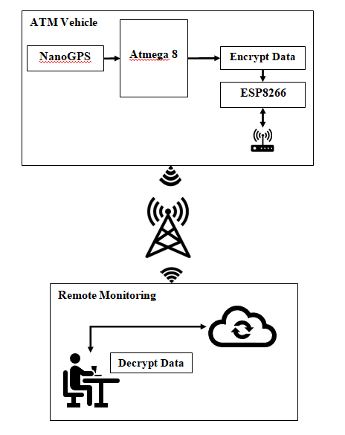
Block Diagram

Slide 11
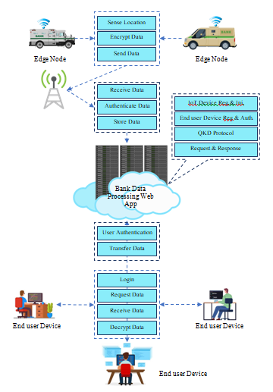
System Architecture

Slide 12
Software Specification
PHP 5
MySQL
WAMP Server 2.0
Macromedia Dreamviewer 8 IDE
Embedded C

Slide 13
Hardware Specification
Nano GPS
Esp8266

Slide 14
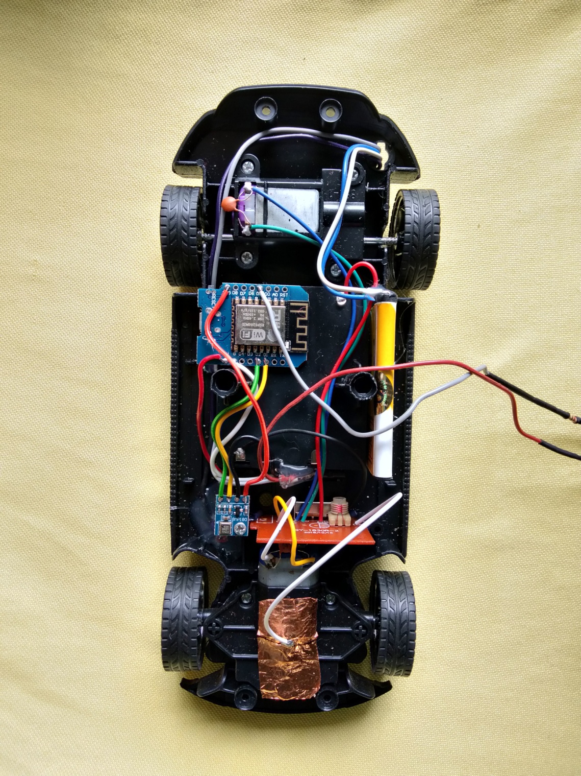
Hardware Output

Slide 15
Project Output
Achieves the unlinkable anonymity of vehicles for outsiders and inside RSUs and NSP and unlinkability between the location, start point, destination, route information and PII to preserve the privacy of the route related information.

Slide 16
Conclusion
IoT is essentially important to improve the quality of human life by the interconnection of different technologies, smart devices, and applications.
At present, ATM vehicle location privacy protection methods play an important role in IoV systems, as they can improve the system and increase Banks’ viscosity.
Data privacy security of a single vehicle. Compared with representative multi-vehicle aggregation solutions, we not only achieve message privacy, confidentiality, integrity, forward and backward security, anti-man in attack and redial attack, but also achieve multi-dimensional aggregation, CCA security and anti-quantum attack.

Slide 17
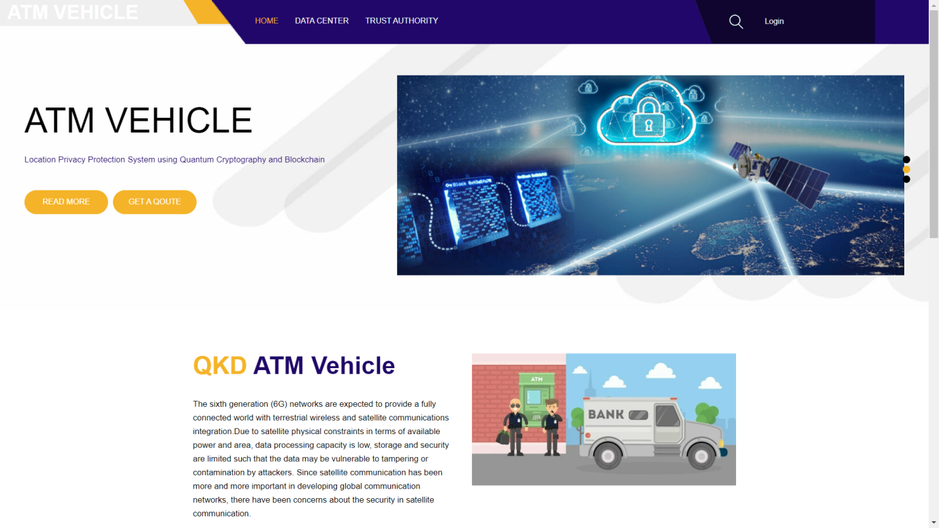
Screenshots
Home Page

Slide 18
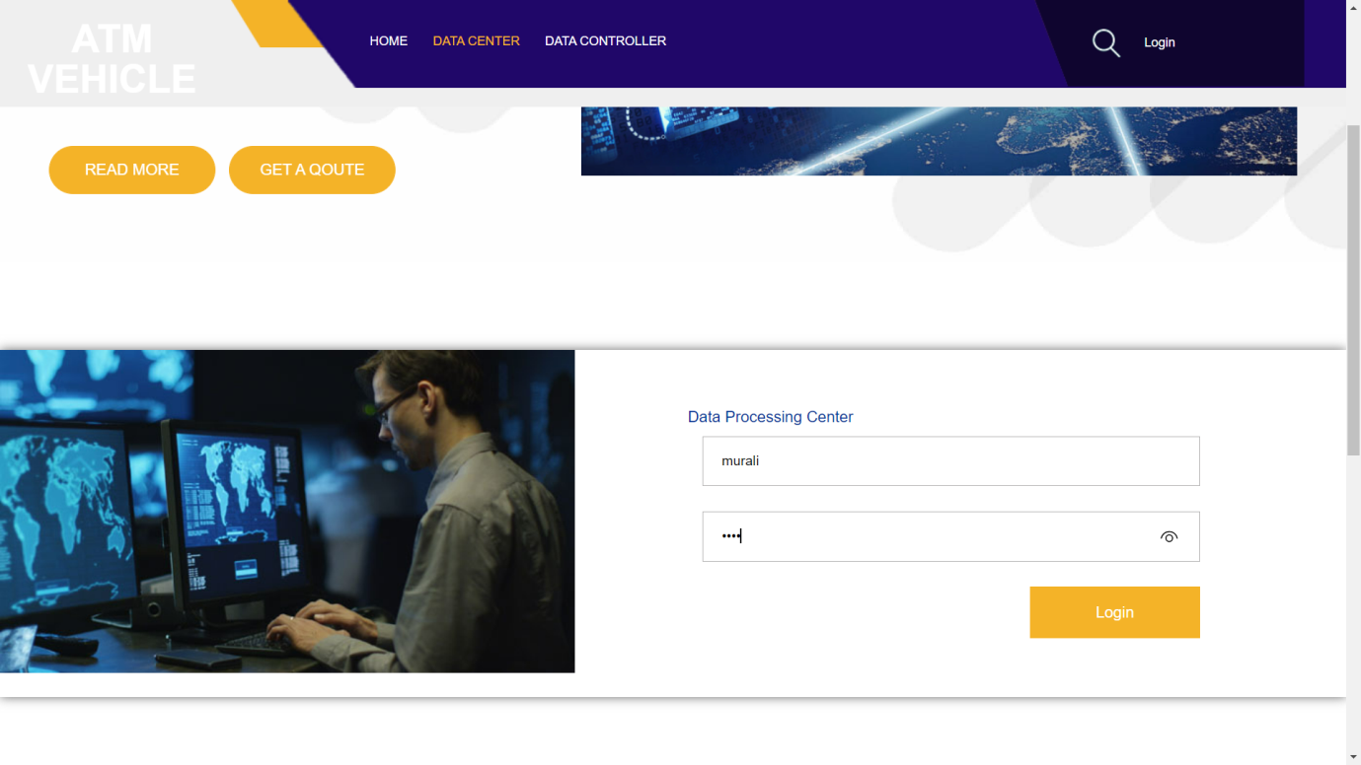
Data Center

Slide 19
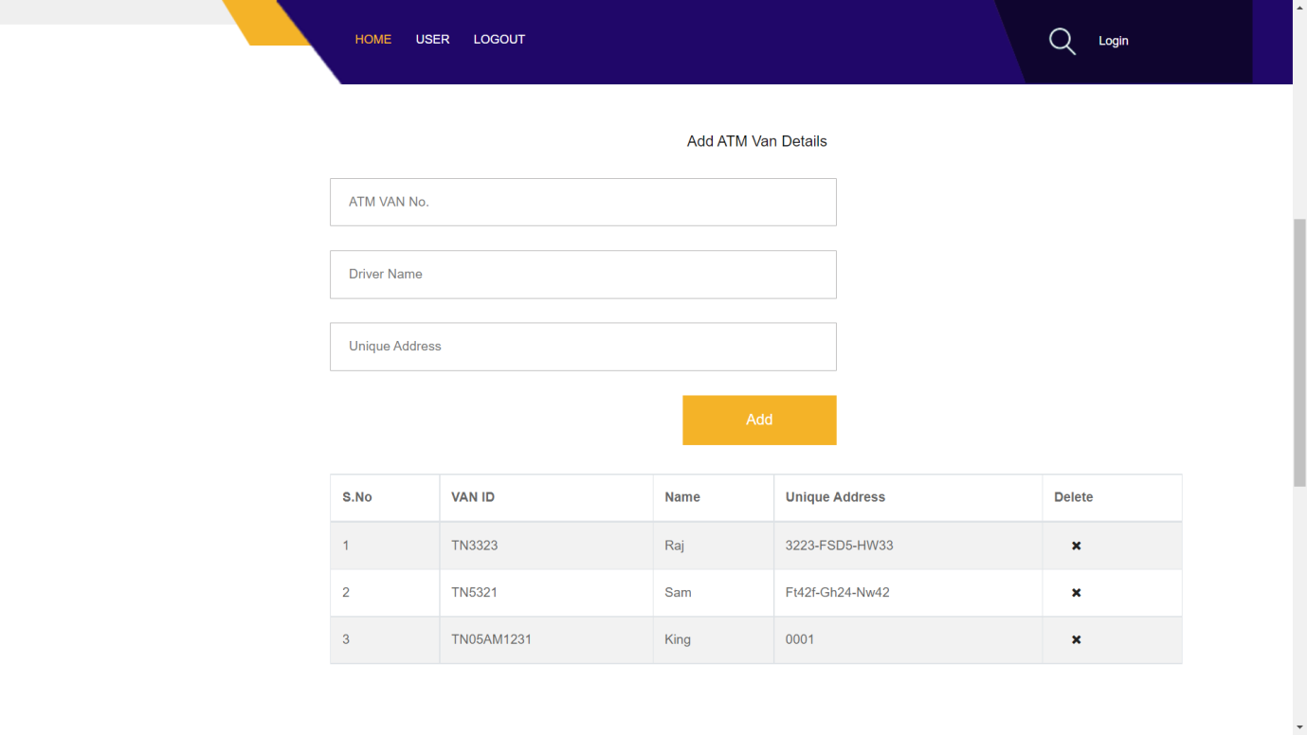
ATM Van Details

Slide 20
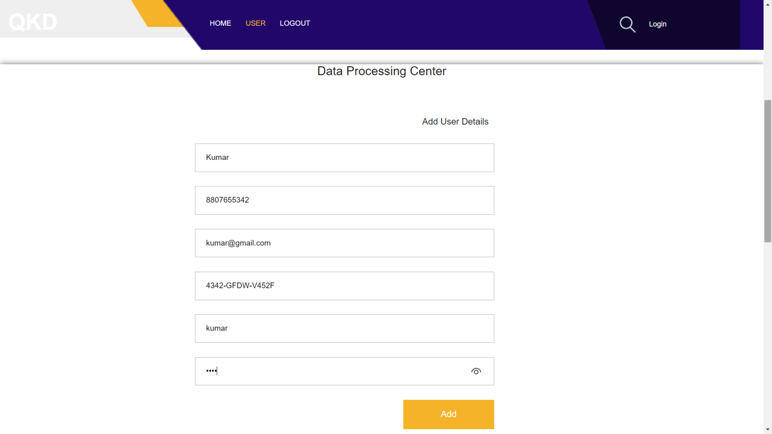
User Login

Slide 21
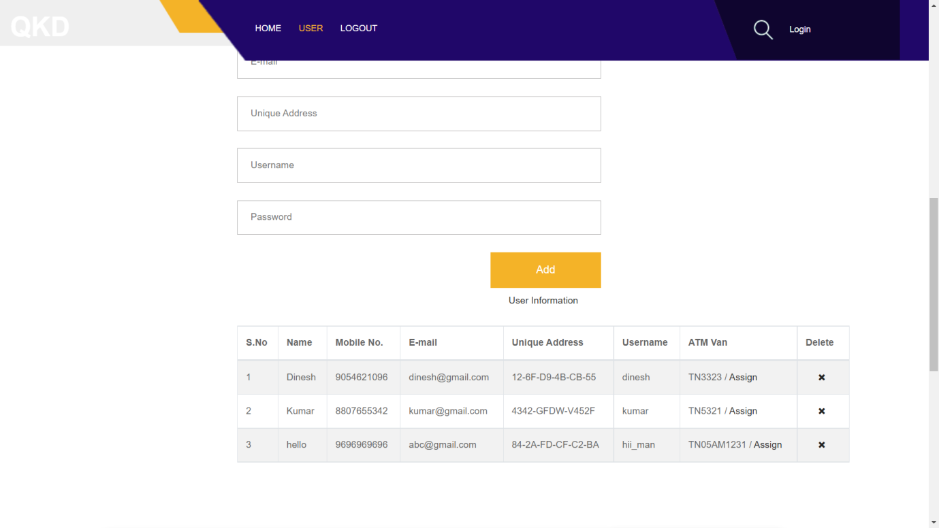
User Information

Slide 22
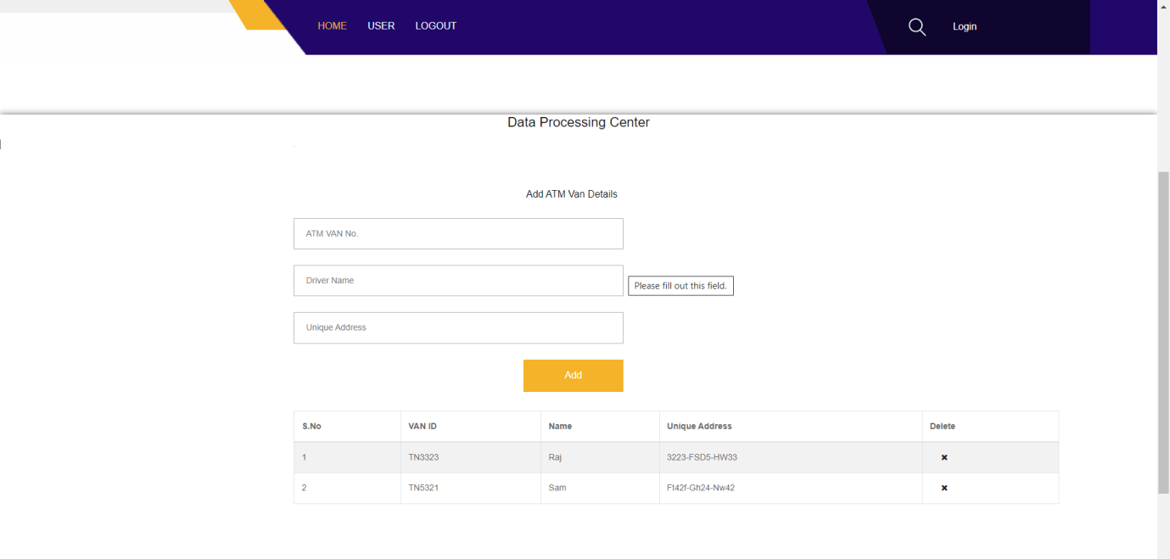
DATA Processing Center

Slide 23
References
J. Qian, Z. Cao, X. Dong, J. Shen, Z. Liu, and Y. Ye, ‘‘Two secure and efficient lightweight data aggregation schemes for smart grid,’’ IEEE Trans. Smart Grid, vol. 12, no. 3, pp. 2625–2637, May 2021.
J. Qian, Z. Cao, M. Lu, X. Chen, J. Shen, and J. Liu, ‘‘The secure lattice-based data aggregation scheme in residential networks for smart grid,’’ IEEE Internet Things J., vol. 9, no. 3, pp. 2153–2164, Feb. 2022.
J. Lin and J. Qian, ‘‘A multi-party secure SaaS cloud accounting platform based on lattice-based homomorphic encryption system,’’ in Proc. Int. Conf. Public Manage. Intell. Soc. (PMIS), Feb. 2021, pp. 1–4.
Y. Liu, W. Guo, C.-I. Fan, L. Chang, and C. Cheng, ‘‘A practical privacypreserving data aggregation (3PDA) scheme for smart grid,’’ IEEE Trans.Ind. Informat., vol. 15, no. 3, pp. 1767–1774, Mar. 2019.

Slide 24
THANK YOU..!

